Slide 1
EduCourse Learner
Jambukiya Harsh Sureshbhai -19BECE30062
Vyas Pragvansh Nimishkumar -19BECE30142
Parmar Ravi Vipulbhai -19BECE30562 GUIDED BY:-
Joshi Meet Dipakkumar -19BECE30547 Pro. Lokesh Gangnani

Slide 2
About the Project:-
The EduCourse learner Web Application is a platform for E-learning.
The online method of learning is best suited for everyone.This digital revolution has led to remarkable changes in how the content is accessed, consumed, discussed and shared.
Unlike classroom teaching , with online learning you can access the content an unlimited number of times.
E-learning is cost effective as compared to traditional form of learning.

Slide 3
Limitations of E-Learning
Online Learning May Create a Sense of Isolation(Need Motivate your self)
Online Learning requires Self- Discipline
Online Learning Requires Additional Training for Instructors
Online Classes Are Prone to Technical Issues

Slide 4
System Requirements(Hardware & Software):-
Hardware:-
Laptop/PC
Internet Connectivity
Software:-
Browser(Chrome or Edge)

Slide 5

Different software development plateform which used in Development Life Cycle:-
Visual Studio code(Text Editor)
Eclipse EE(Enterprice Edition),JVM
Browser

Slide 6

Technologies Used:-
HTML
CSS, BootStrap
Javascript
Jquary
Mysql
Servlets
JSP

Slide 7
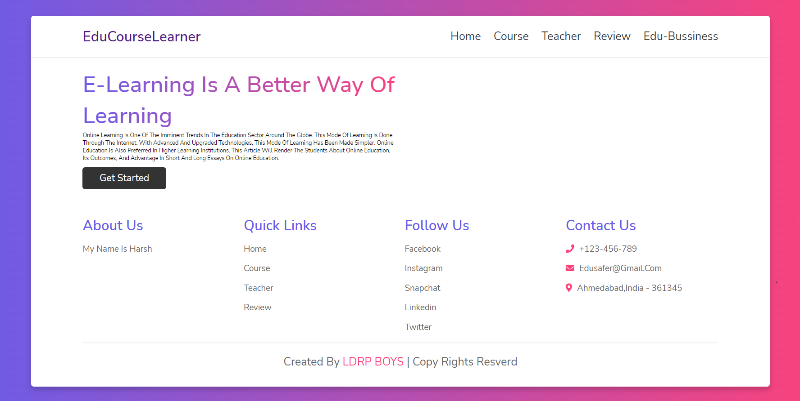
Screenshorts:- 1)Home Page

Slide 8
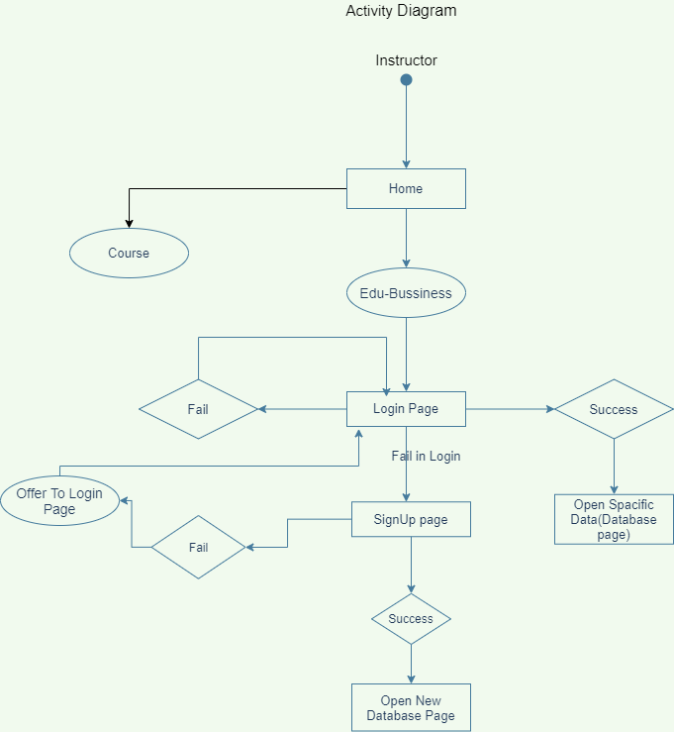
Instructor’s Activity Diagram

